Slide 1
Slide
Slide
Analyzing Amazon’s Co-Purchasing Network
with Apache Spark
Slide
Slide
Slide
Slide
Slide

Slide 2
Slide
Team Members
[Working under the guidance of Dr. Animesh Chaturvedi]
Slide
Mahendra Singh Puniya
[20bcs082]
Rishabh Gautam
[20bcs112]
Slide
Slide
Slide
Slide
Dipesh Mishra [20bcs043]
Ravikant [20bcs110]
Slide

Slide 3






Slide
Table of Contents
Slide
Slide
Introduction
Algorithm
Slide
Objective
Result
Slide
Dataset
Conclusion
Slide 2
Slide
Slide 1

Slide 4
Slide
Slide
Utilizing Amazon's 2003 Product Co-purchasing Network data, this project employs Apache Spark and the Connected Components algorithm to unveil co-purchasing behavior patterns. The goal is to identify related product clusters for more effective recommendation systems and marketing strategies. The subsequent sections cover dataset exploration, Spark-driven analysis, and practical implications of our findings in the age of big data.
Slide
Introduction
Slide
Slide
Slide
Slide

Slide 5
Slide
The analysis utilizes Apache Spark's GraphX library and the Connected Components algorithm to identify related product clusters within the Amazon Co-purchasing Network. Its objectives are to uncover co-purchasing behavior patterns, providing insights for recommendation systems, marketing strategies, and customer behavior analysis. This highlights Apache Spark's efficiency in processing large-scale network data for data-driven e-commerce decision-making.
Slide
Slide
Objective
Slide
Slide
Slide
Slide

Slide 6
Slide
Slide
The Amazon Product Co-purchasing Network, collected in June 2003, consists of 403,394 nodes and 3,387,388 edges. In this network, if a product 'i' is frequently co-purchased with product 'j', a directed edge is created from 'i' to 'j'.
Slide
Dataset
Slide
Slide
Slide
Slide

Slide 7
Slide
ALGORITHM
Slide
Slide
01
03
Run the Connected Component Algorithm
Load the Graph
Slide
02
Slide
Construct the Graph
Slide
Slide

Slide 8
Slide
ALGORITHM
Slide
Slide
04
06
Extract Component IDs
Sort Component
Slide
05
Calculate Component Size
Slide
Slide
Slide

Slide 9
Slide
ALGORITHM
Slide
Slide
07
08
Print the Results
Stop the Spark Context
Slide
Slide
Slide
Slide

Slide 10
Slide
import org.apache.spark.graphx.{Graph, GraphLoader}
object ConnectedComponentsAnalysis {
def main(args: Array[String]): Unit = {
val spark = SparkSession.builder()
.appName("Connected Components Analysis")
.getOrCreate()
val graph = GraphLoader.edgeListFile(spark.sparkContext, "D:/7th Sem/Data Science System/Project/Amazon0601.txt")
val connectedComponents = graph.connectedComponents().vertices
val componentSizes = connectedComponents
.map { case (_, componentId) => (componentId, 1) }
.reduceByKey(_ + _)
val sortedComponents = componentSizes
.sortBy { case (_, size) => size }
.collect()
.reverse
for ((componentId, size) <- sortedComponents) {
println(s"Connected Component ID: $componentId, Component Size: $size")
}
spark.stop()
}
}
Slide
Slide
Code
Slide
Slide
Slide
Slide

Slide 11
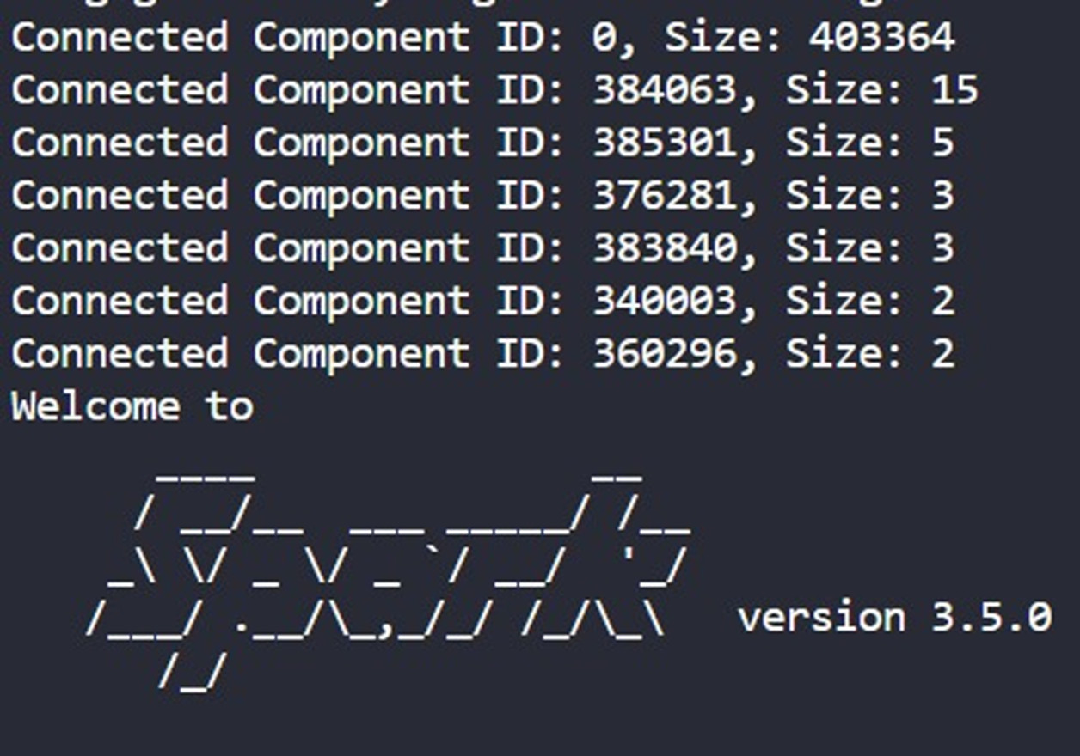
Slide
Slide
Slide
Result
Slide
Slide
Slide
Slide

Slide 12
Slide
CONCLUSION
Slide
Slide
In conclusion, our analysis of the Amazon Product Co-purchasing Network using Apache Spark and the Connected Components algorithm provided valuable insights into customer behavior. We identified product clusters, revealing co-purchasing patterns. Apache Spark's efficiency in handling large-scale network data emphasizes its role in e-commerce decisions. These findings have practical implications for recommendations, marketing, and customer satisfaction on Amazon, highlighting the impact of data science tools on extracting insights from big datasets.
2
Slide
Slide
Slide
Slide

Slide 13
Slide
Slide
Thanks for Listening with great patience
Slide
Slide
Slide
Slide
Slide

